Slide 1
Identifying numbers with Hopfield neural networks
Balazs Magyar
C56QME

Slide 2
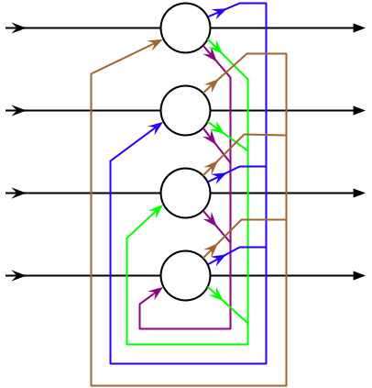
Introduction
The problem: identifying similar vectors
Traditional method: calculating Hamming-distances, then ordering the list
Neural method: building a Hopfield neural network

Slide 3
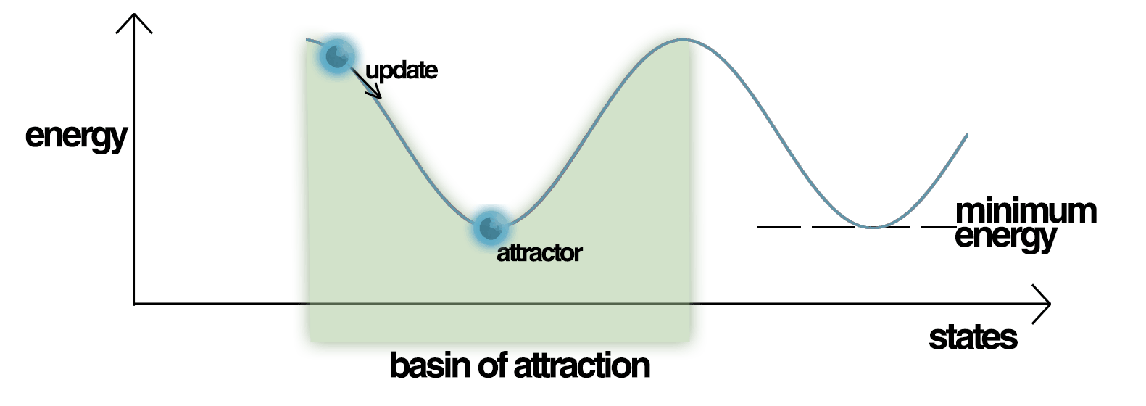
The Model
We teach the network the source patterns, these become local minima
The energy of the network decreases with every iteration, until it reaches one of these points.

Slide 4
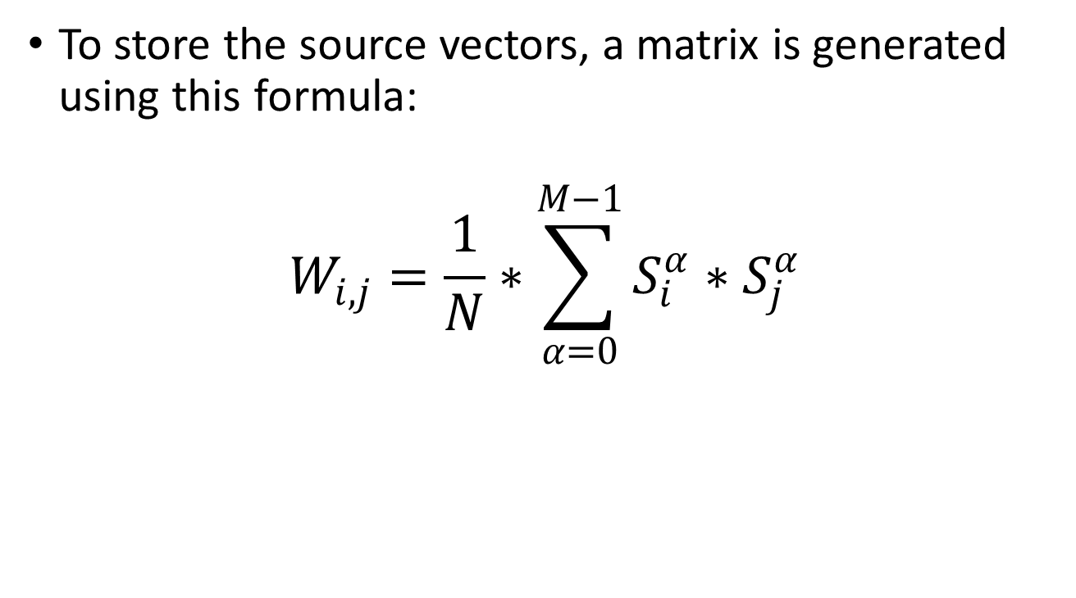
„Teaching” the network
To store the source vectors, a matrix is generated using this formula:
$$W_{i,j}=\frac{1}{N}∗\sum_{α=0}^{M−1}{S_{i}^{α}∗S_{j}^{α}}$$

Slide 5
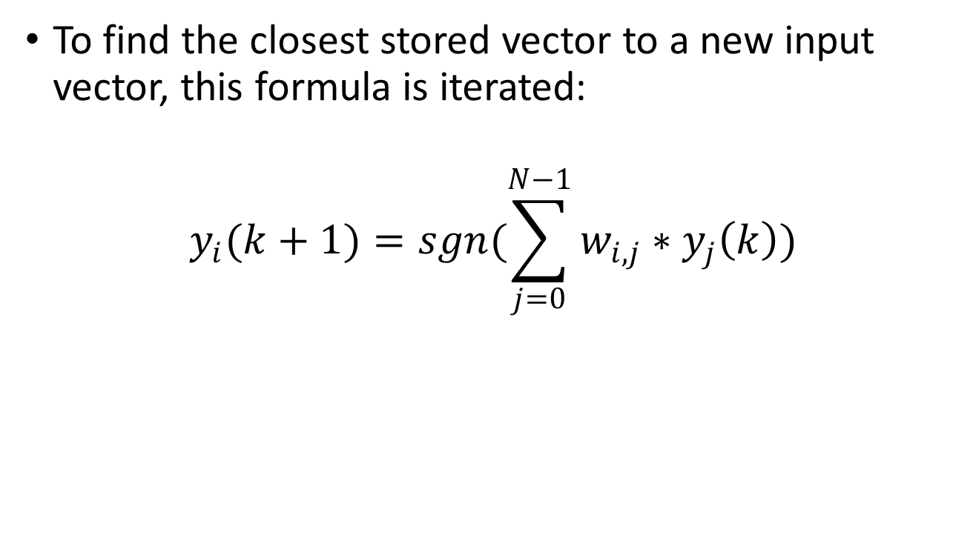
Identifying input vectors
To find the closest stored vector to a new input vector, this formula is iterated:
$$y_{i}(k+1)=sgn(\sum_{j=0}^{N−1}{w_{i,j}∗y_{j}\left(k\right)})$$

Slide 6
Spurious Steady States
Sometimes the network will converge to spurious patterns (different from the training patterns).
The energy in these spurious patterns is also a local minimum.
For each stored pattern x, the negation -x is also a spurious pattern.

Slide 7
Implementation
To implement a solution, I translated these mathematical formulas to the C# language.
An easy-to-use user interface was created using Windows Forms.
The source code is available at https://github.com/magyarb/adahf

Slide 8
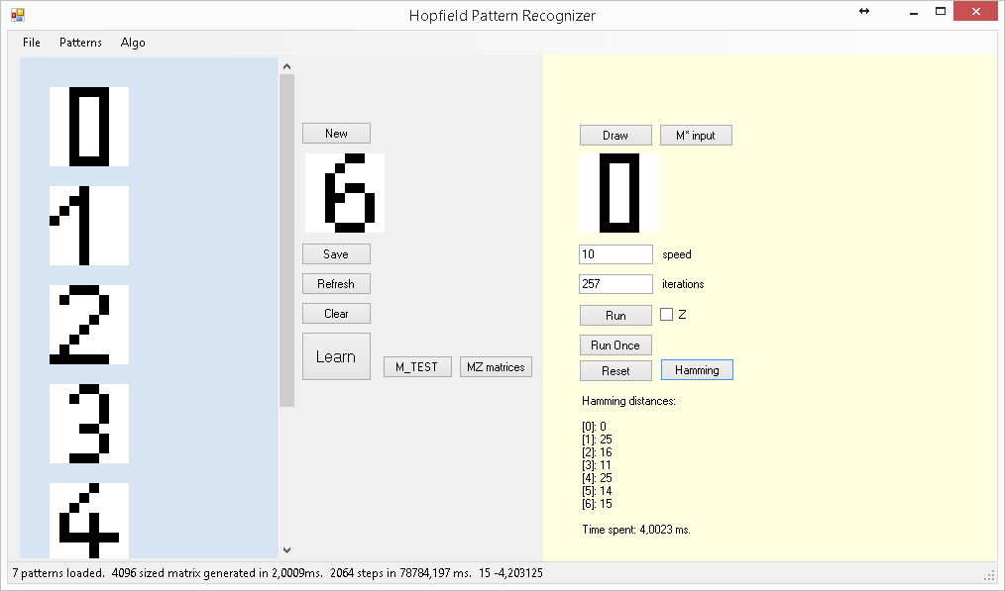
Implementation (UI)

Slide 9
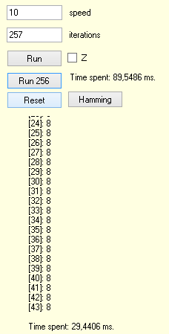
Performance
The speed of the traditional method is ~0.7*source vector count ms, plus the time of finding the minimum of the resuting list. O(n)
The speed of the neural method is constant 90-120ms, after the matrix is generated O(1)

Slide 10
Conclusion
The neural solution is faster, if we have more than 100 source patterns.
This network can store N source vectors.
The current task was to identify numbers on 8 by 8 black and white images, so the traditional method is faster.

Slide 11
List of references
Wikipedia, [Online]. Available: https://en.wikipedia.org/wiki/Hopfield_network
R. Wang. [Online]. Available: http://fourier.eng.hmc.edu/e161/lectures/NeuralNetworks/node5.html
L. A. Belanche, "Hopfield networks," [Online]. Available: http://www.cs.upc.edu/~belanche/Docencia/apren/2009-10/Teoria/tema9.pdf
Zawersh at Wikipedia, CC BY-SA 3.0 https://commons.wikimedia.org/w/index.php?curid=4107292

Slide 12
QUESTIONS?

Slide 13
DEMO

